Slide 1



Digital Twin-Enabled Incentive Learning for Dynamic Sensing Agents in Smart Transportation Cyber-Physical Systems
Weiwei Hu, Yuichi Ohsita, Shimonishi Hideyuki*
The University of Osaka, Japan
2026.05.14，Perth
9th IEEE International Conference on Industrial Cyber-Physical Systems
1

Slide 2
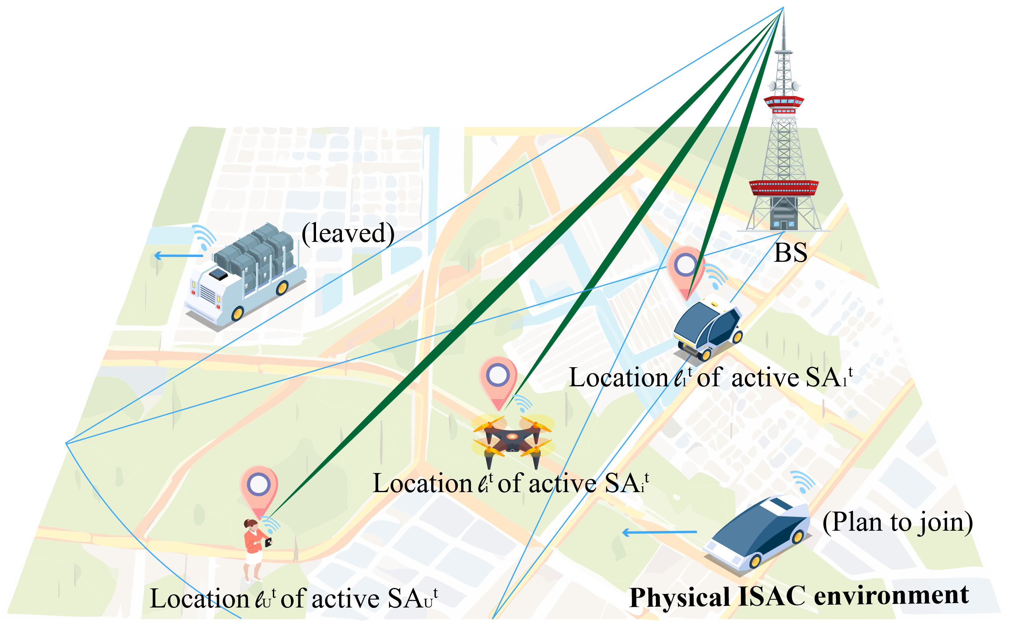
Background
Challenge
In smart transportation, base station (BS) need to achieve real-time detection of the environment.
BSs are limited by fixed sensing angles and
long distances.
Integrated Sensing and Communication (ISAC)
Solution
ISAC technology enables BS to recruit sensing agents (SAs) for sensing tasks.
Notes:
加入图， 更加详细的介绍TCP map定义

Slide 3
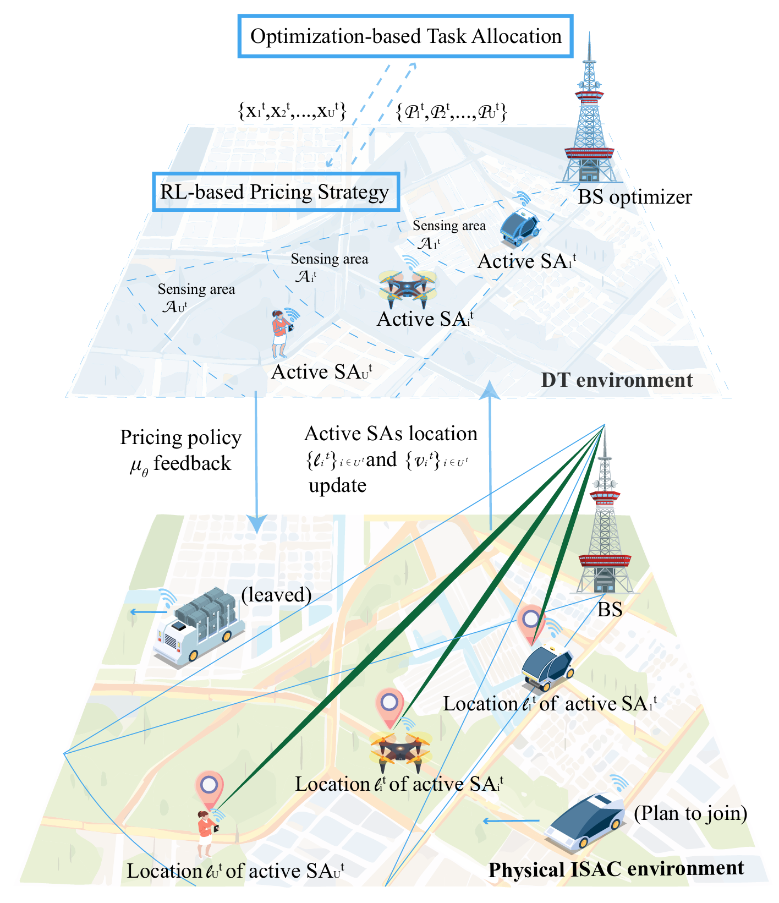
System Overview
Challenge
RL-based incentives enable SAs to learn pricing strategies through interactions [1],
it assumes a fixed set of SAs, without considering joining and leaving of SAs.
Solution
Digital twin (DT) can train in the digital twin and execute in the real world at the real time.
[1] B. Gu, X. Yang, Z. Lin, W. Hu, M. Alazab, and R. Kharel, “Multiagent actor-critic network-based incentive mechanism for mobile crowdsensing in industrial systems,” IEEE Transactions on Industrial Informatics, vol. 17, no. 9, pp. 6182–6191, 2021.
DT-enabled incentive learning
Notes:
加入图， 更加详细的介绍TCP map定义

Slide 4
Related Work
Related Work
ISAC cooperative sensing lacks incentive mechanisms [2][3][4]
Existing works do not fully consider dynamic joining and leaving of SAs [1][5]
Contribution of Our Work
Design a digital twin-based training framework for policy learning
Propose an algorithm for scalable incentive learning
Support stable pricing policies under dynamic SA churn
[2] K. Meng, C. Masouros, A. P. Petropulu, and L. Hanzo, “Cooperation ISAC networks: Performance analysis, scaling laws, and optimization,” IEEE Transactions on Wireless Communications, vol. 24, no. 2, pp. 877–892, 2025.
[3] Y. Wang, K. Zu, L. Xiang, Q. Zhang, Z. Feng, J. Hu, and K. Yang, “ISAC enabled cooperative detection for cellular-connected UAV network,” IEEE Transactions on Wireless Communications, vol. 24, no. 2, pp. 1541–1554, 2025.
[4] Z. Wei, H. Liu, H. Li, W. Jiang, Z. Feng, H. Wu, and P. Zhang, “Integrated sensing and communication enabled cooperative passive sensing using mobile communication system,” IEEE Transactions on Mobile Computing, vol. 24, no. 9, pp. 7805–7821, 2025.
[5] S. He, D.-H. Shin, J. Zhang, J. Chen, and P. Lin, “An exchange market approach to mobile crowdsensing: Pricing, task allocation, and walrasian equilibrium,” IEEE Journal on Selected Areas in Communications, vol. 35, no. 4, pp. 921–934, 2017.
Notes:
加入图， 更加详细的介绍TCP map定义

Slide 5
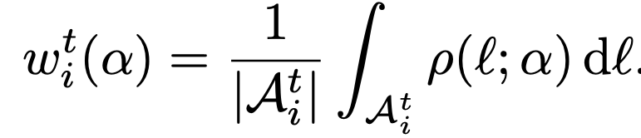
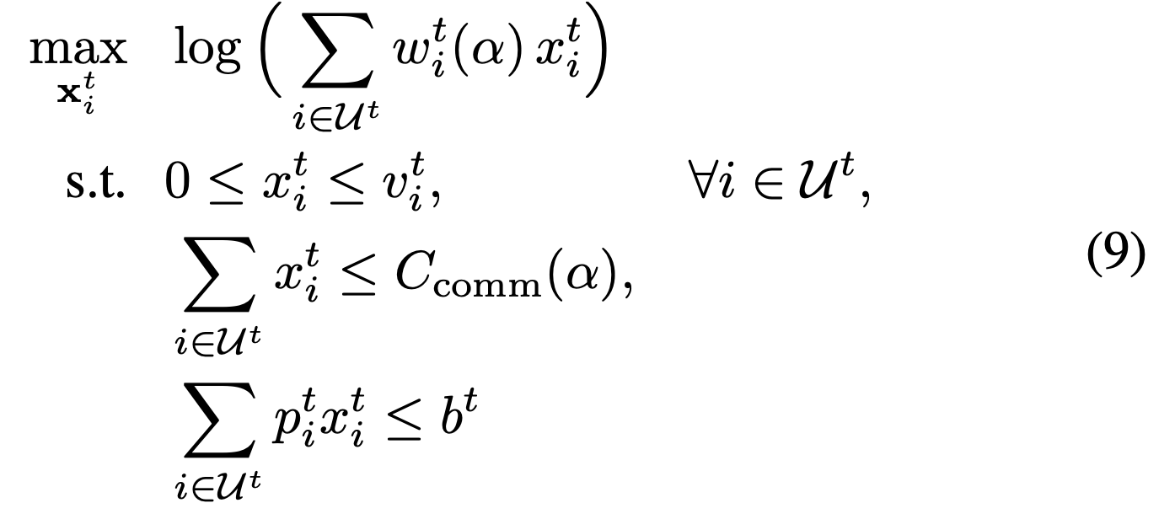


System Model
BS-side Task Allocation Optimization
BS sensing
Residual importance density
$Bs = αB$ , $α ∈ [0, 1]$
Uplink communication of sensing task
The sensing weight of each SA $i$
BS quality
Payoff of BS maximization
Detection quality
Resolution gain
Notes:
加入图， 更加详细的介绍TCP map定义

Slide 6
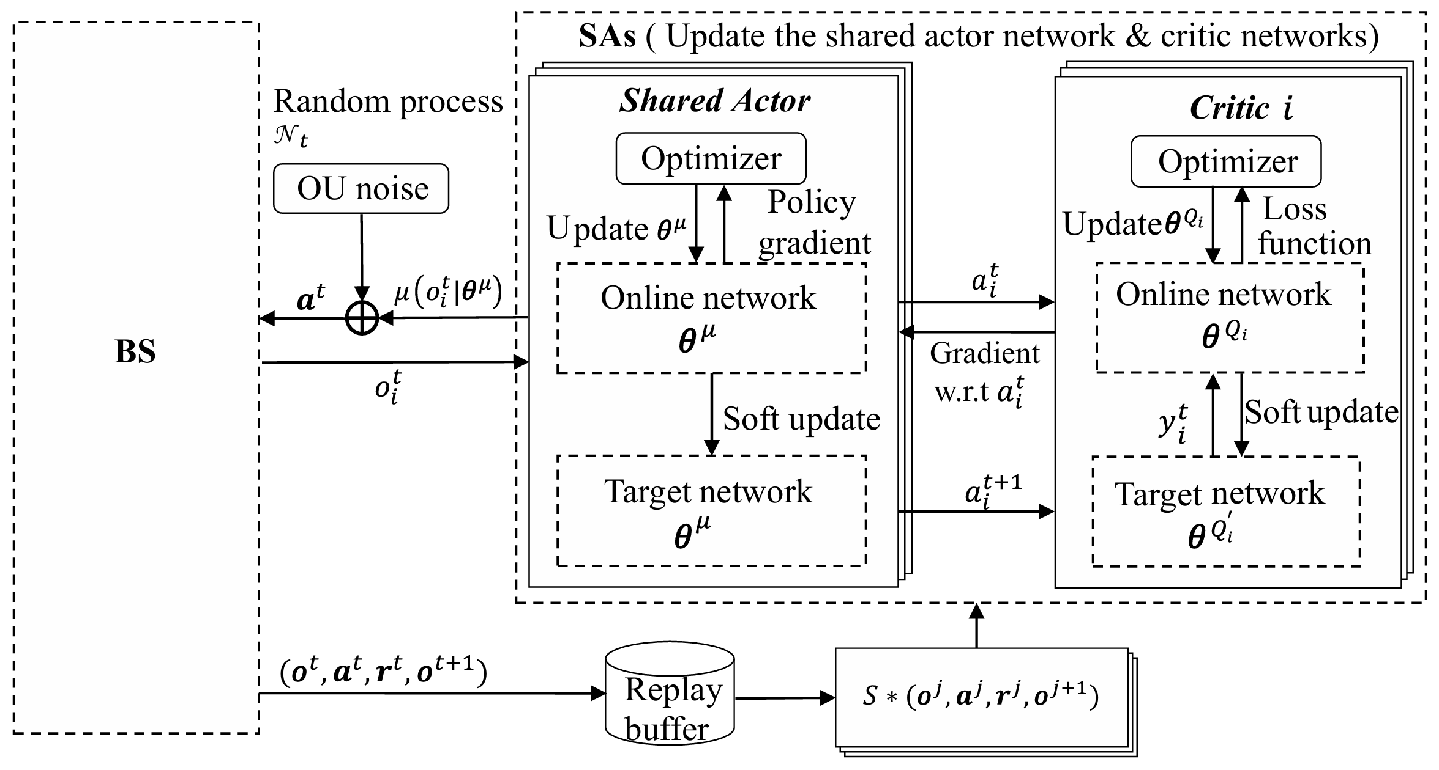
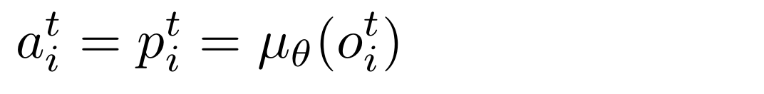
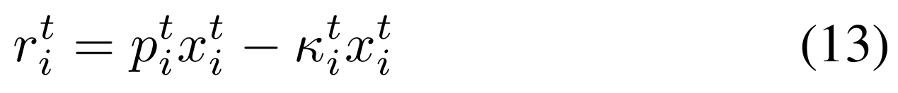
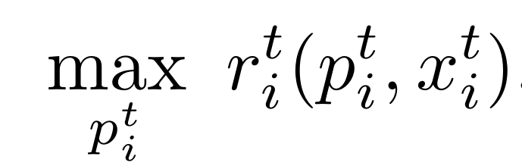
System Model
SA-side Learning
Observation
Action
Reward
Payoff of each SA maximization
SAN-MADDPG architecture
Notes:
加入图， 更加详细的介绍TCP map定义

Slide 7
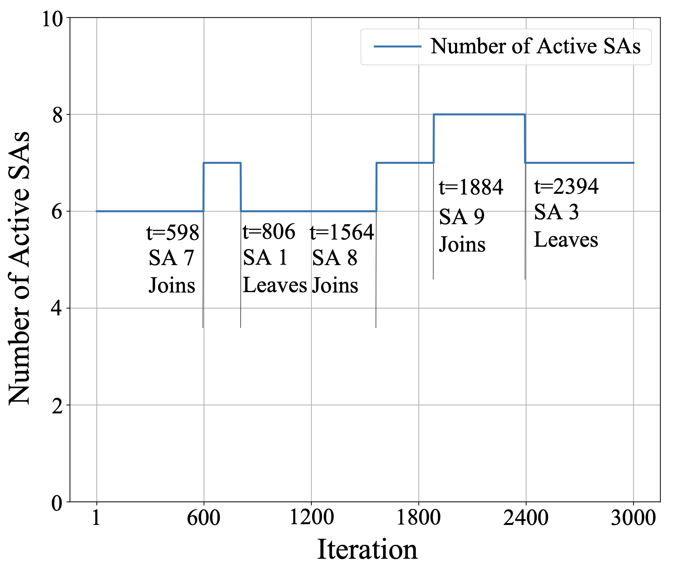
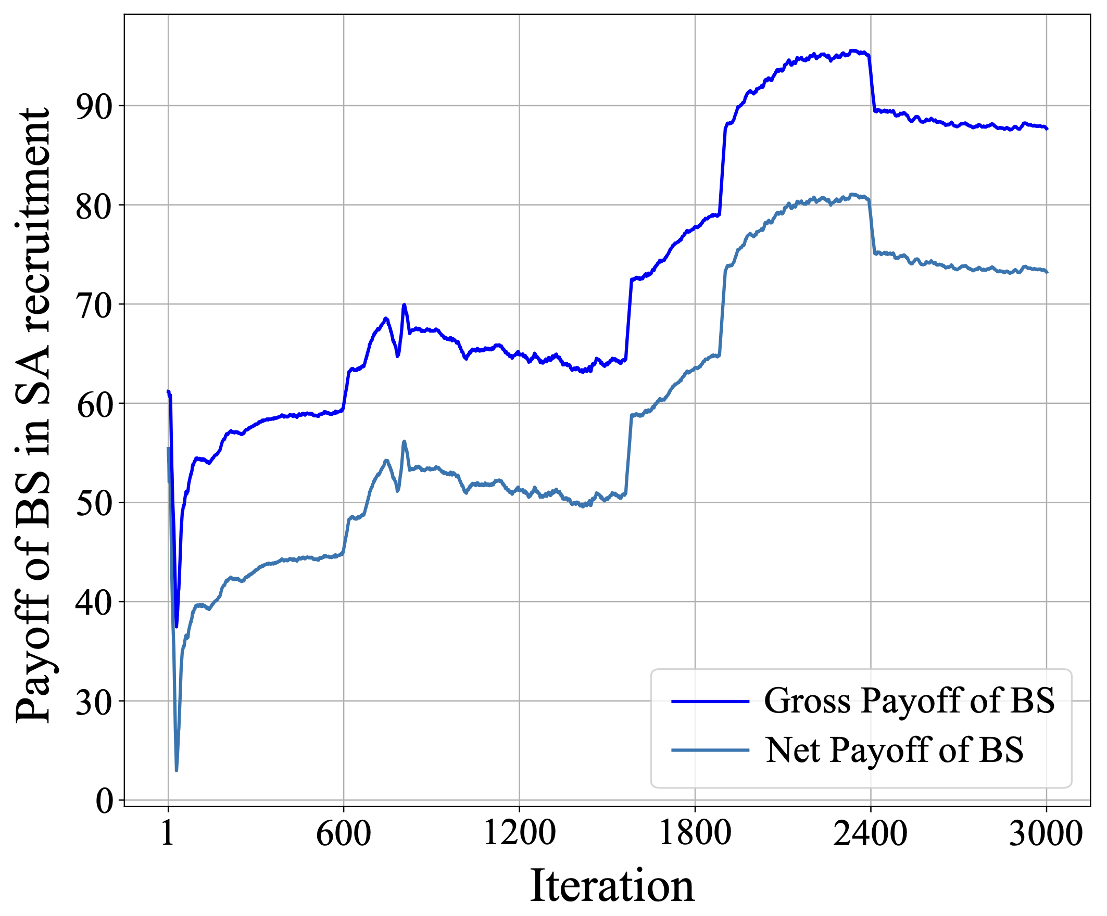
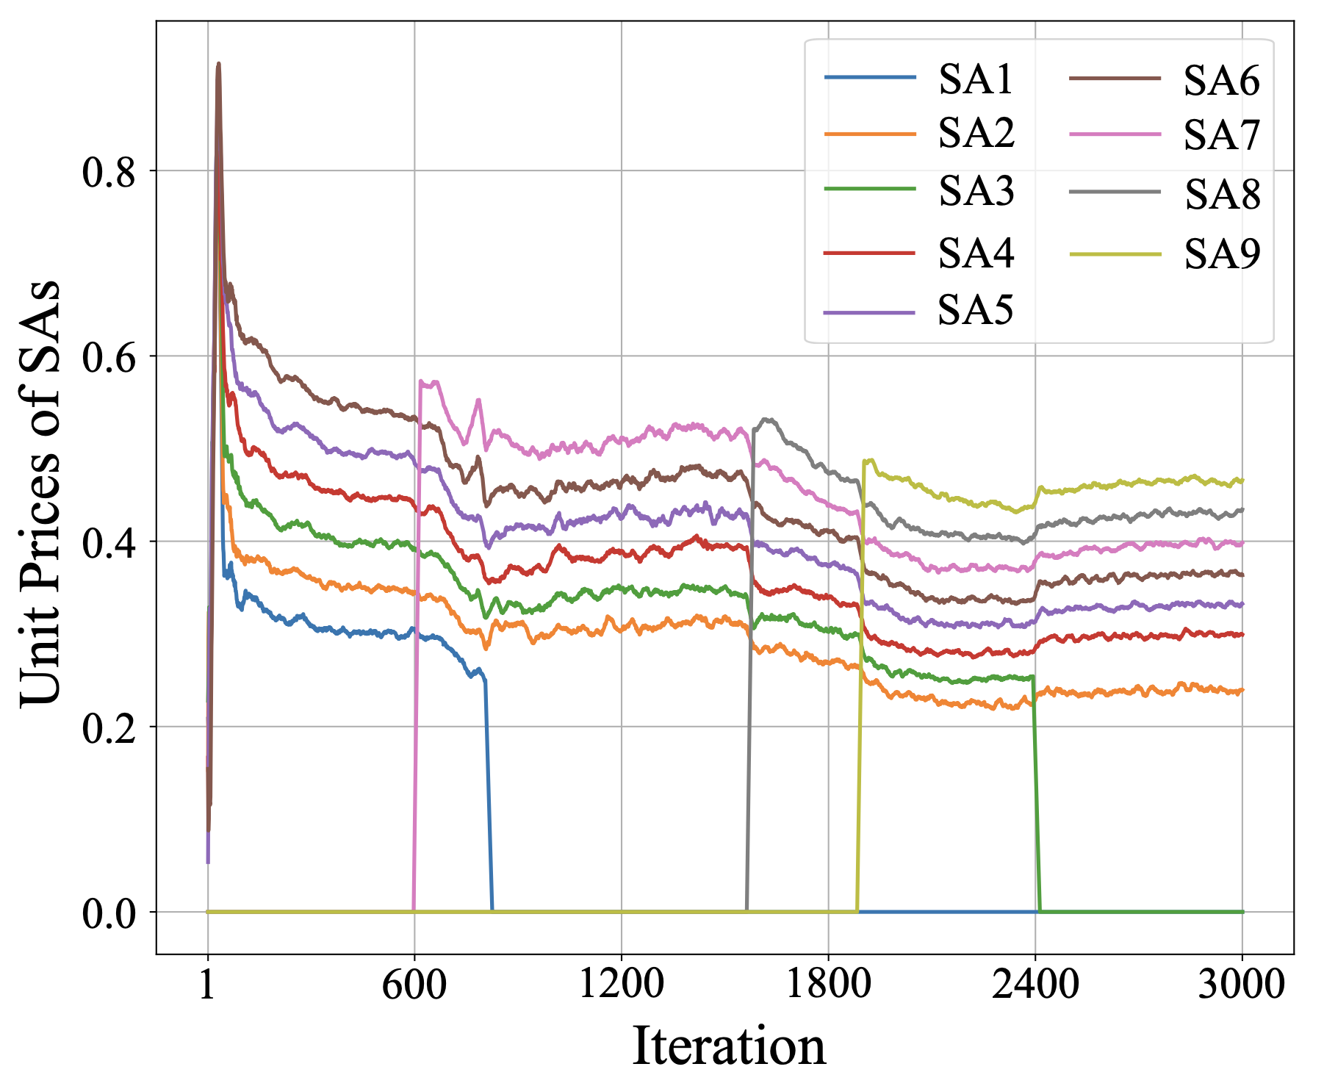
Result
Convergence of SAN-MADDPG under dynamic joining and leaving of SAs
Number of active SAs
BS gross/net payoff
Unit prices of SAs
Price of each SA is proportional to its contribution
Dynamic joining and
Leaving of SAs
Notes:
加入图， 更加详细的介绍TCP map定义

Slide 8
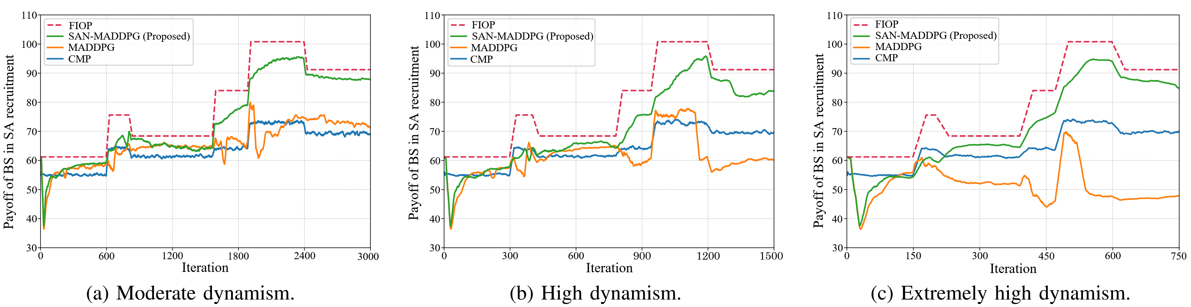
Result
BS payoff comparison of SAN-MADDPG and other methods in three scenarios
FIOP (Full-Information Optimal Pricing): Assuming that the BS and SAs know global parameters.
SAN-MADDPG: each SA here maintains its own (non-shared) actor and updates it via CTDE.
CMP (Consensus-Mean Pricing): Each SA sets its price close to the average price across all SAs.
Notes:
加入图， 更加详细的介绍TCP map定义

Slide 9
Q & A
9

Slide 10
THANK YOU
Weiwei Hu
u865915h@ecs.osaka-u.ac.jp
9th IEEE International Conference on Industrial Cyber-Physical Systems
10

